Slide 1
Unit-5 Security in the cloud
The concerns, threats and risks
Sanjay Babu Jaiswal

Slide 2
Security in the cloud
Companies planning to use cloud services must be assured of tight, well-
defined security services. Many levels of security are required within a cloud environment:
✓ Identity management: For example, so that any application service or even hardware component can be authorized on a personal or group role basis.
✓ Access control: There also needs to be the right level of access control within the cloud environment to protect the security of resources.
✓ Authorization and authentication: There must be a mechanism so the right people can change applications and data.

Slide 3
A comprehensive security infrastructure must be provided at all levels and types of cloud services.
Developers also need tools that allow them to secure the services they design to be delivered in the cloud.
Organizations need consistent security across their own data center environments that intersect with a cloud service.

Slide 4
Raising questions…
01
02
03
04
05
06
Does the cloud provider use a third party to assess its own security risks?
Does the cloud provider understand your data preservation and protec-
tion needs?
Where does your data physically live? Do you have the cloud provider’s
assurance that it will remain private?
Can the cloud provider keep security information such as private keys private?
Does your cloud provider have well implemented patch management
policies and procedures?
Does the cloud provider have a well-defined, well-executed identity and access management architecture?
Notes:
Note: you can add between 3 and 6 sections, the structure can vary. The numbers have to be kept

Slide 5
01
TYPES OF RISKS IN CLOUD COMPUTING

Slide 6
Threat #1—Misuse and illicit use of cloud computing: Lawless individuals may take advantage of the befitting registration, straightforward methods and somewhat anonymous access to cloud services to launch diverse attacks.
Examples of such attacks include:
-- password and key breaking,
-- Distributed Denial-of-Service (DDoS),
-- malicious data hosting,
-- commencing dynamic strike points,
-- botnet command/control and
-- CAPTCHA-solving farms.
Targets are:
-- Infrastructure as a Service (IaaS),
-- Platform as a Service (PaaS).

Slide 7
Threat #2—Insecure interfaces and APIs: Customers organize and combine with cloud services through interfaces or APIs. Providers should double-check that security is incorporated into their service forms, while users should be cognizant of security risks in the use, implementation, and administration and monitoring of such services.
API dependencies, logging capabilities, inflexible access to controls, anonymous access, reusable passwords, clear-text authentication, transmission of content and improper authorizations are the example of such risks.
Targets are IaaS, PaaS, SaaS.

Slide 8
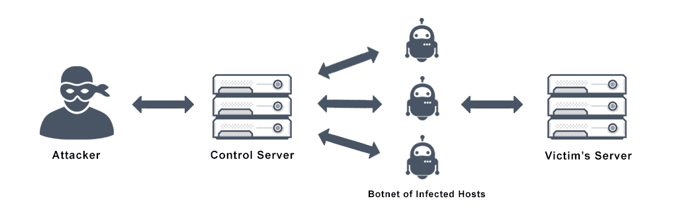
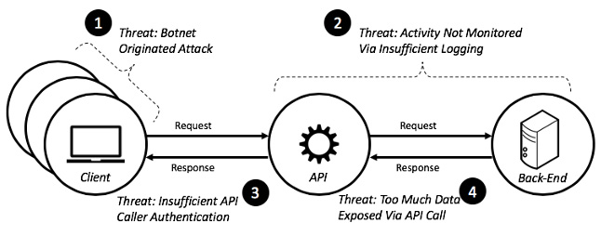

Slide 9
Threat #3—Vicious insiders: Vicious insiders represent a larger risk in a cloud computing environment, since clients don’t have a clear outlook of provider principles and procedures.
Vicious insiders can gain unauthorized access into organizations and their assets.
Some risks encompass impairment, economic influence and decrease of productivity.
Targets are IaaS, PaaS, SaaS.

Slide 10
Threat #4—Issues-related technology sharing: IaaS is based on distributed infrastructure, which is often not conceived to accommodate a multi-tenant architecture.
Overlooked flaws have authorized visitors to gain unauthorized rights on the platform.
Targets are IaaS.

Slide 11

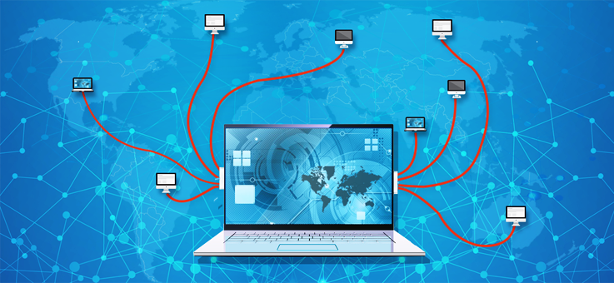

Slide 12
Threat #5—Data loss or leakage: Compromised data may encompass:(i) deleted or changed data without producing a backup,
(ii) unlinking a record,
(iii) decrease of an encoding key and
(iv) unauthorized access to perceptive data.
The likelihood of data compromise considerably rises in cloud computing, due to the architecture and operations.

Slide 13
Examples of data loss/ leakage include:
(i) insufficient authentication,
(ii) authorization,
(iii) review controls,
(iv) inconsistent encryption,
(v) inconsistent programs keys,
(vi) operational flops,
(vii) disposal challenges,
(viii) risk of association,
(xi) jurisdiction/political issues,
(x) persistence and trials,
(xi) datacentre reliability and catastrophe recovery.
Targets are IaaS, PaaS, SaaS.

Slide 14
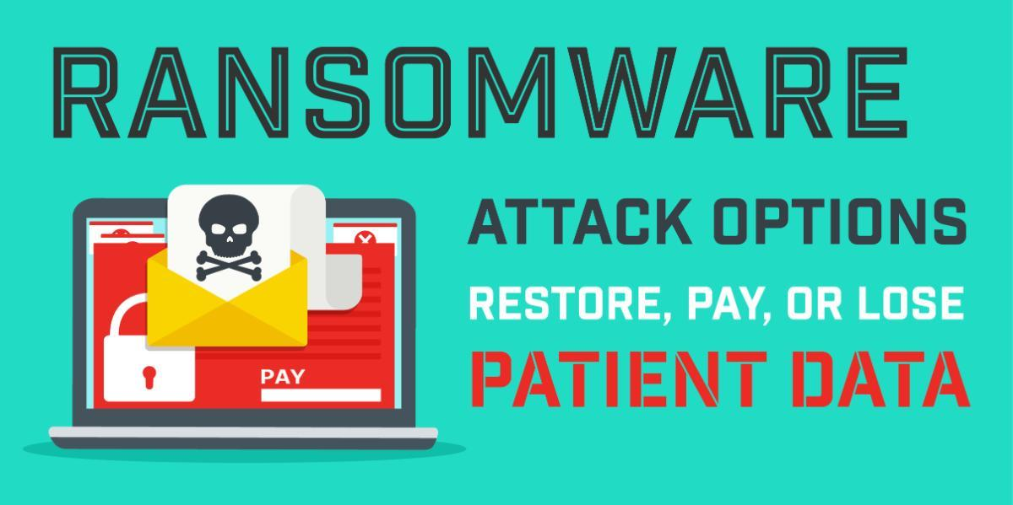

Slide 15
Threat #6—Hijacking (Account/Service): Account or service hijacking is generally carried out with pilfered (stolen) credentials.
Such attacks encompass phishing, deception and exploitation of programs vulnerabilities.
Using pilfered(to steal something in small quantity) credentials, attackers can access critical localities of cloud computing services and compromise the confidentiality, integrity and accessibility (CIA) of such services.
Examples of such attacks include :
-- eavesdropping on transactions/sensitive undertakings, -- manipulation of data,
-- coming back with falsified data,
-- redirection to illegitimate sites.

Slide 16
Threat #7—Unknown Risk Profile: Cloud services signify the organizations that are less engaged with hardware and software ownership and maintenance.
Although this boasts important benefits, organizations should be cognizant that matters like internal security systems, security compliance, configuration hardening, patching, auditing and logging may be overlooked.
So it is important to pay attention to these unknown risks.

Slide 17
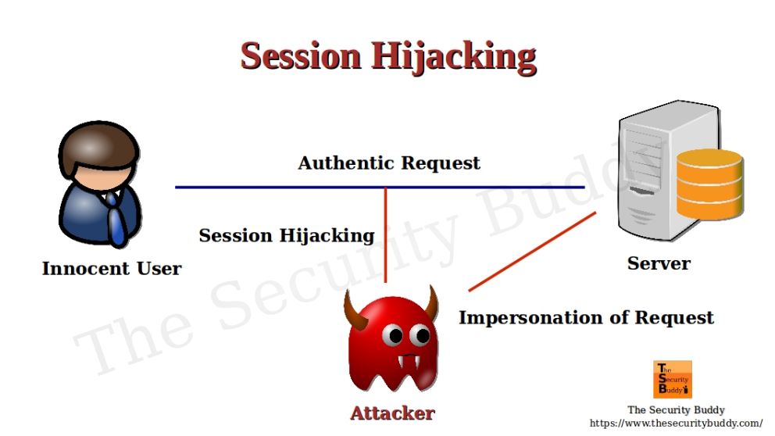
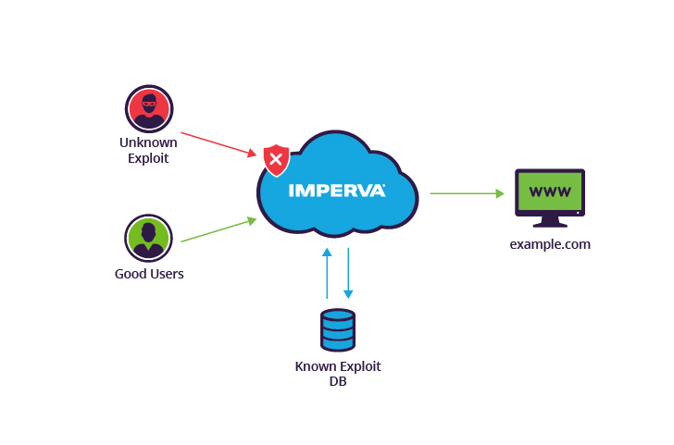

Slide 18
02
Security mechanisms

Slide 19
What are Cloud Security Mechanisms ?
Cloud security, also known as cloud computing security, is a collection of security measures designed to protect cloud-based infrastructure, applications, and data. These measures ensure user and device authentication, data and resource access control, and data privacy protection.
These tools and mechanisms include encryption, IAM (Identity and access management ) and single sign-on (SSO), data loss prevention (DLP), intrusion prevention and detection systems (IPSes/IDSes) and public key infrastructure (PKI).

Slide 20
These are the different steps for providing security mechnisms in the cloud.
Step 1: Determine Security Policy
Step 2: Implement Security Policy
Step 3: Reconnaissance /study
Step 4: Vulnerability Scanning
Step 5: Penetration Testing
Step 6: Post-Attack Investigation

Slide 21
Step 1: Determine Security Policy
A security policy is a full security roadmap.
Usage policy for networks, servers, etc.
User training about password sharing, password strength, social engineering, privacy, etc.
Privacy policy for all maintained data
2. A schedule for updates, audits, etc.
3. The network design should reflect this policy.
The placement/protection of database/file servers.
The location of demilitarized zones (DMZs).
The placement and rules of firewalls.
The deployment of intrusion detection systems (IDSs).

Slide 22
Step 2: Implement Security Policy
Installing and configuring firewalls.
Rules for incoming packets should be created .
These rules should drop packets by default .
Rules for outgoing packets may be created .
Installing and configuring IDSes.
snort is a free and upgradeable IDS for several platforms .
Most IDSs send alerts to log files regularly.
Serious events can trigger paging, e-mail, telephone.

Slide 23
Step 3: Reconnaissance /study
First, we learn about the network.
IP addresses of hosts on the network.
Identify key servers with critical data.
Services running on those hosts/servers.
Vulnerabilities on those services.
Two forms: passive and active.
Passive reconnaissance is undetectable.
Active reconnaissance is often detectable by IDS.

Slide 24
Step 4: Vulnerability Scanning
Steps to conduct vulnerability scanning on your cloud interface to check whether the system has any weaknesses.
Scan for a list of hosts and services.
Scan for targets on these services.
Many scanners will detect vulnerabilities (e.g. Nessus).
These scanners produce a risk report.
Other scanners will allow you to exploit them (e.g. metasploit).
These scanners find ways in, and allow you to choose the payload to use (e.g. obtain a root shell, download a package).

Slide 25
Step 5: Penetration Testing
After identifying vulnerabilities,
An exploit attack is done to check the intensity of vulnerability.
This involves writing code or testing functions accepting user input.

Slide 26
Step 6: Post-Attack Investigation
Forensics of attacks.
Retain chain of evidence.
The evidence in this case is the data on the host.
The log files of the compromised host hold the footsteps and fingerprints of the attacker.
Every minute with that host must be accounted for.
For legal reasons, you should examine a low-level copy of the disk and not modify the original.

Slide 27
Different mechanisms used in cloud securty.
1. Encryption:
The data, by default, is coded in a readable form known as plaintext. When transmitted over a network, the risk is unauthorized and potentially dangerous access.
Encryption technology relies on a standard algorithm called cipher to convert original text data into encrypted data, called ciphertext.
When encryption is used for listening data, data is paired with a string of characters called an encryption key. The decryption key is used to decrypt ciphertext back to its original writing format.

Slide 28
There are two types of encryption known as symmetric encryption and asymmetric encryption.
Asymmetric and symmetric encryption are two primary techniques used to secure data.
Symmetric encryption uses the same key for both encryption and decryption,
Examples: 3DES, AES, DES and RC4
Asymmetric encryption uses a pair of keys: a public key for encryption and a private key for decryption.
Examples: Diffie-Hellman, ECC, El Gamal, DSA and RSA

Slide 29
2. Hashing:
Hashing is the conversion of a string of characters into a limited number of short lengths or a key that reflects the original string.
There are many well-known hash functions used in cryptography. These include message-digest hash works MD2, MD4, and MD5, which is used to incorporate digital signatures into a short form called message-digest, and the
Secure Hash Algorithm (SHA), a standard algorithm, which makes it large (60- bit) digestion message and similar to MD4.

Slide 30
3. Digital Signatures:
The digital signature mechanism is a means of providing data integrity, data authenticity through authentication, and non-repudiation.
A message is assigned a digital signature prior to transmission, and if the message experiences any subsequent, unauthorized modifications then it is rendered as invalid.
A digital signature provides evidence that the message received is the same as the original message sent by the rightful sender.
Both hashing and asymmetrical encryption are involved in the creation of a digital signature, which exists as a message digest that was encrypted by a private key and appended to the original message.

Slide 31
4. Single Sign-On :
The single sign-on (SSO) mechanism enables one cloud service consumer to be authenticated by a security broker, which establishes a security context while the cloud service consumer accesses cloud-based IT resources.
The advantage to the SSO machine is how it enables independent IT resources to generate and distribute operational authorization and validation signals.
SSO Security Vendor assists when a cloud buyer needs access to cloud-based services.

Slide 32
5. Public Key Infrastructure:
A common approach for managing the issuance of asymmetric keys is based on the PKI (public key infrastructure) mechanism, which exists as a system of protocols, practices, rules, and data formats that enable large-scale systems to securely use public-key cryptography.
PKIs have digitally signed data structures that rely on the use of digital certificates, that bind public keys to certificate owner identities.
A third-party certificate authority (CA) digitally signs the Digital certificates.
The components of a PKI include a CA that issues the certificates, a registration authority (RA) to approve the issuance of the certificates, a public directory containing the issued certificates, and the certificate revocation list (CRL).

Slide 33
6. Identity and Access Management:
Cloud Identity and Access Management typically include the following features:
Single Access Control Interface: Cloud IAM solutions provide a clean and consistent access control interface for all cloud platform services. All cloud services can use the same interface.
Enhanced Security: We can define increased security for critical applications.
We can define roles and grant permissions to users for allowing them to access resources at different granularity levels.

Slide 34
03
Vulnerabilities

Slide 35
Vulnerabilities
These are flaws in a computer system that weakens the overall security of the device/system.
In spite of security features, cloud computing adds some key security issues. Some of these key security challenges are summarized as follows:
● Investigation: Investigating an illegal undertaking may be unrealistic in cloud environments. Cloud services are particularly hard to enquire, because data for multiple clients may be co-located and may also be dispersed over multiple datacentres.
Users have little information about the mesh topology of the inherent environment.
Service provider may also enforce limits on the network security of the users.

Slide 36
Vulnerabilities
● Data segregation: Data in the cloud is normally distributed simultaneously with data from other customers.
Encryption will not be presumed as the single solution for data segregation issues.
Some clients may not desire to encrypt data because there may be a case when encryption misleads can decimate the data.

Slide 37
Vulnerabilities
Long-term viability: Service providers should double-check the data security in altering enterprise positions, such as mergers and acquisitions.
Customers should double-check data accessibility in these situations. Service provider should furthermore confirm data security in contradictory situations such as extended outage, etc.

Slide 38
Vulnerabilities
● Compromised servers: In a cloud computing environment, users do not even have an alternative of utilizing personal acquisition toolkit.
In a situation where a server is compromised, they require to shut their servers down until they get a backup of the data. This will further create source accessibility concerns.

Slide 39
Vulnerabilities
Regulatory compliance: Traditional service providers are exempted from outside audits and security certifications.
If a cloud service provider does not adhere to these security audits, then it directs to a conspicuous decline in clientele trust.

Slide 40
Vulnerabilities
● Recovery: Cloud service providers should double-check the data security in natural and man-made disasters.
Generally, data is duplicated over multiple sites. However, in the case of any such redundant happenings, provider should do an absolute and fast restoration.

Slide 41
04
Governance strategies

Slide 42
What is cloud governance?
Cloud governance is the process of defining, implementing, and monitoring a framework of policies that guides an organization’s cloud operations.
This process regulates how users work in cloud environments to facilitate consistent performance of cloud services and systems.

Slide 43
Centralization
Centralization refers to the practice of consolidating a set of security controls, processes, policies, and services and reducing the number of places where security needs to be managed and implemented.
For example, a common set of services should be built for allowing users to be authenticated and authorized to use cloud services as opposed to having each application provide different solutions.
All of the security controls related to the application stack should be administered from one place, as well.

Slide 44
Standardization
Standardization is the next important strategy. Security should be thought of as a core service that can be shared across the enterprise, not a solution for a specific application.
Each application having its own unique security solutions is the equivalent of adding doors all over the side of the building in the grocery store analogy.

Slide 45
Standardization
Companies should look at implementing industry standards for accessing systems, such as OAuth and OpenID, when connecting to third parties.
Leveraging standard application protocols like Lightweight Directory Access Protocol (LDAP) for querying and modifying directory services like Active Directory or ApacheDS is highly recommended, as well.

Slide 46
Automation
The third strategy is automation. A great example of the need for automation comes from the book called The Phoenix Project.
This book tells a fictional, yet relevant, story of a company whose IT department was always missing dates and never finding time to implement technical requirements such as a large number of security tasks.
Over time, they started figuring out what steps were repeatable so that they could automate them. Once they automated the process for creating environments and deploying software, they were able to implement the proper security controls and process within the automation steps.

Slide 47
Classes of Threats
Disclosure (telling publically)
Snooping (look around secretly)
Deception (abc in real but shows 12)
Modification, spoofing, repudiation of origin, denial of receipt
Disruption (break chain)
Modification
Modification, spoofing, delay, denial of service

Slide 48
Security Issues in Cloud Computing
•Unique security features:
–Co-tenancy(shared responsibility)
–Lack of control on outsourced data and application
•General concerns among cloud customers:
–Inadequate policies and practices
–Insufficient security controls
•Customers use cloud services to serve their clients
•Need to establish trust relationships
•Beneficial to both stakeholders

Slide 49
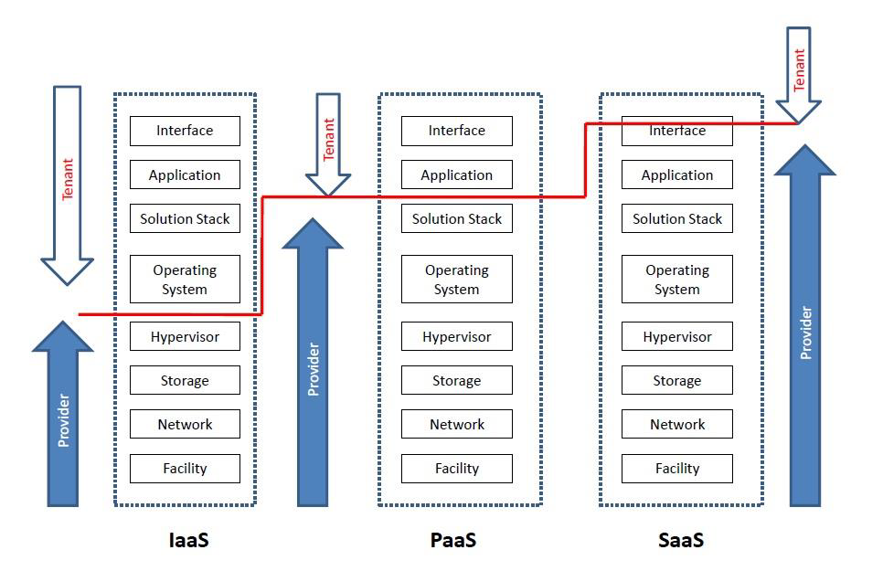
Security responsibilities in cloud

Slide 50
Developing a Secure, Accountable, Reliable Cloud Environment

Slide 51
In order to secure cloud-based systems, there are a number of areas to focus the security controls on. Here are some of the most important areas:
• Policy enforcement
• Encryption
• Key management
• Web security
• API management
• Patch management
• Logging
• Monitoring
• Auditing

Slide 52
Cloud SecurityFundamentals :
Cloud security is the first and foremost concern of every industry using cloud services. A cloud Vendor must ensure that the customer does not face any difficulties such as loss of data or data theft.
Data integrity, privacy issues, authentication issue, data loss, user-level
security and vendor-level security are some of the basic concerns of cloud computing.
These fundamental problems in cloud computing scenario can be defined as cloud risks.

Slide 53
Cloud Risk :
When infrastructure, applications, data and storage are hosted by cloud providers then there is a huge risk in each type of service offering. This is known as cloud risk.
Several aspects apart from cost and offered services must be evaluated before choosing a particular cloud provider.
Security is of utmost importance while considering a cloud computing environment. Sometimes, physical location of the servers may also be a factor for sensitive data.

Slide 54
Cloud Risk Division :
These risks can be divided into four major categories :
1. Policy and organizational risks
2. Technical risks
3. Legal risks
4. Other risks

Slide 55
Policy and organizational risks:
1. Lock-in :
When applications, data and serivices are dependent on only one cloud provider it is known as lock-in problem.
There could be SaaS lock-in, PaaS lock-in, and IaaS lock-n.
Lock-in problem occurs because of high customization of servicses according to user demand.
2. Loss of governance :
The cloud provider may sub-contract or outsource services to third parties that may not compromise the same gurantees as issued by the provider.
Loss of control and governance could lead to the impossibilty of fulfilling the security requirements , lack of confidentiality, integrity and availability of data, degradation of perfomance and qaulity of services.

Slide 56
3. Compliance challenges :
Compliance challenges are one of the major reasons that companies are holding back from using cloud services.
Standards and regulations, such as the Massachusetts Privacy Law (201 CMR 17), PCI-DSS, SOX, Nevada SB-227 and HIPAA, are requiring many organizations to evaluate their data protection measures.
Virtually every regulation requires organizations to adequately protect their physical and informational assets.

Slide 57
4. Cloud service termination or failure :
There must be 24*7 support and high availabilty of all services but in the competitive world of IT, an inadeqaute business strategy, lack of financial support and other factors could lead some providers to shut down their businesses.
And it is possible that for short period of time some cloud computing services could be terminated.
5. Supply chain failure :
There is possibilty that the cloud provider could outsource some services to third parties.
In that case, any interruption or corruption in the chain between all parties involved can lead to inaccessibilty of services, loss of data confidentiality.

Slide 58
Technical risks
Following are the technical risks :
1.Isolation failure.
2.Resource exhaustions
3.Cloud provider malicious insider
4.Intercepting data in transit
5.Insecure or ineffective deletion of data

Slide 59
Technical risks
6.Conflicts between customer hardening procedures and cloud environment
7.Loss of encryption keys
8.Malicious probes or scams
9. Compromise service engine

Slide 60
Legal risks :
Following are some legal risks :
1. Risk from changes of jurisdiction :
2. Licensing risks :
3. Data protection risks :

Slide 61
Other risks :
Apart from policy, technical and legal risks, following are some other risks :
1. Backup lost or stolen :
2. Unauthorized access to premises :
3. Theft of computer euipment :
4. Natural disasters :

Slide 62
Cloud Computing Security Architecture
Cloud security architecture is the umbrella term used to describe all hardware, software and infrastructure that protects the cloud environment and its components, such as data, workloads, containers, virtual machines and APIs.
There are four layers in the generic architecure of cloud i.e. user layer, service provider layer, VM layer and datacenter layer, which are described as follows :

Slide 63
1. Data center layer : This layer is related to the traditional infrastructure security concers. It consists of physical hardware security, theft protection, newtork security, and all physical assets security.
2. VM layer : This layer involves VM level security issues, VM monitoring, hypervisor-related issues and VM isolation management issues.

Slide 64
3. Service provider layer : This layer is responsible for identity and access management, service level agreement(SLA), metering, compliance and audit-realted issues.
4.User layer : This is the first layer of user interaction. It is responsible for user authorization and all browser-related security issues.

Slide 65
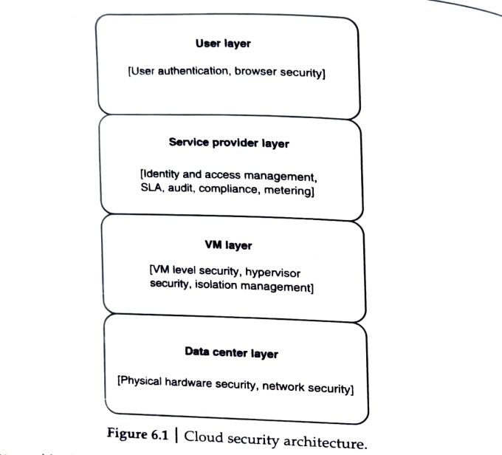

Slide 66
The cloud security architecture provides documentation for how the organization will:
Define security principles, rules, procedures and governance for all cloud services and applications from development through runtime
Properly configure activities and operations within the cloud to maintain optimal security
Define identity and access management (IAM) rights for all cloud users

Slide 67
Secure data, applications and other assets.
Outline updating and patching procedures, roles and responsibilities.
Maintain compliance with relevant industry and government regulations.
Connect cloud security practices, tools and technologies with the broader enterprise architecture and enterprise security strategy.

Slide 68
Why is cloud security architecture important?
When migrating to the cloud, security can be an afterthought for many organizations. This leaves the organization open to risks and threats specific to the cloud environment that are not protected by traditional on-premise security measures and tools.
Many organizations have deployed a series of point solutions to improve security in the cloud, this patchwork a whilepproach can significantly limit visibility, which makes it difficult to achieve a strong security posture.

Slide 69
4 key elements of cloud security architecture
1.Cloud security posture management (CSPM): Focuses on security of cloud APIs, preventing misconfigurations and integrations into the CI/CD pipeline.
2.Cloud Workload Protection Platform (CWPP): Oversees runtime protection and continuous vulnerability management of cloud containers.

Slide 70
3.Cloud Access Security Broker (CASB): Works to improve visibility across endpoints that includes who is accessing data and how it is being used.
4.Cloud application security: Application-level policies, tools, technologies, and rules to maintain visibility into all cloud computing activity and protect cloud-based applications throughout the development lifecycle.

Slide 71
VM Security Challenges :
In a cloud context, more recent assaults might be caused via VM rootkits, hypervisor malware, or guest hopping and hijacking. Man-in-the-middle attacks against VM migrations are another form of attack.
Typically, passwords or sensitive information are stolen during passive attacks. Active attacks could alter the kernel’s data structures, seriously harming cloud servers.

Slide 72
1. Communication between Vms or between Vms and host
2. VM escape
3. VM monitoring from host
4. VM monitoring form another VM
5. Denial of service.

Slide 73
6. External modifications of VM
7. External modifications of the hypervisor
8. Mixed trust level VMs
9. Resource contention

Slide 74
Cloud databases and File systems in Cloud
Understand the concepts of cloud database
Operational Model for Cloud Database
Types of Cloud Database
Cloud File System
Distributed File System Basics
Concept of GFS and HDFS
Comparisons of Features

Slide 75
Cloud database is a database that runs on a cloud computing platform like Amazon EC2, Rackspace and GoGrid.
There are two ways to deploy a databse -
(i) users can either run the database inside a secured virtual machine(VM)
(ii) or subscribe for particular database services managed by a cloud service provider.
Currently, there are some SQL-based and some NoSQL-based database offerings.
Cloud Database :

Slide 76
Operation Model for Cloud Database :
There are two primary methods for running a database on the cloud:
1. Virtual Image(VM) image :
Cloud platforms allows users to purchase VM instances for a limited time. A cloud provider facilitates more security for running databases inside a VM. If users have thier own VM image, then they upload it and run the database inside that or do so through presinstalled databases. Oracle, for example, provides the preinstalled image with the Oracle database 11g for Amazon EC2 instances.

Slide 77
2. Database as a service :
DBaaS (also known as managed database service) is a cloud computing service that lets users access and use a cloud database system without purchasing and setting up their own hardware, installing their own database software, or managing the database themselves.
The market for DBaaS and cloud databases is among the fastest-growing Software-as-a-Service (SaaS) markets.

Slide 78
Benefits :
Compared to deploying a database management system on-premises, DBaaS offers your organization significant financial, operational, and strategic benefits:
-Cost savings
-Scalability—up and down
-Simpler, less costly management
-Rapid development and faster time-to-market
-Data and application security
-Reduced risk
-Software quality

Slide 79
Types of Cloud Database:
1 – Amazon Web Service (AWS) :
Amazon has become the market leader in the DBaaS space. It offers supplementary data-management services such as Redshift, a data warehouse and Data Pipeline, which is a data integrating service for easier data management. Amazon’s current offerings include:
Amazon RDS – Amazon’s Relational Database Service runs on either Oracle, SQL or MySQL server instances.
Amazon SimpleDB – This is primarily a schema-less database that is meant to handle smaller workloads.
Amazon DynamoDB – This falls on the NoSQL databases (SSD), capable of automatically replicating workloads across three availability zones.

Slide 80
Strengths: Lots of Features, Easy to Use, Good Support and Documentation
Weaknesses: Not Too Customizable, Downtimes as per Amazon’s Schedule

Slide 81
2. Oracle Database :
Oracle Database provides companies with enterprise-scale database technology stored in the cloud. Despite its first offering being quite comprehensive, the Generation 2 offering has consistently higher performance with extensive governance and security controls.
Data migration is also covered with a dedicated solution and tight customer support in case any technical issues or questions arise.
Strengths: Intuitive Interface, Easy to Use, Solid Customer Support
Weaknesses: No Free Version, No Mobile Access, Pricey for Small Companies

Slide 82
3. Microsoft Azure :
Azure is a cloud computing platform for VM creation, building and running web-based applications, smart client applications, and XML web services.
It currently boasts the biggest and strongest global infrastructure, with 55 regions, more than any other cloud provider.
Strengths: Intuitive Interface, Easy to Use, Solid Customer Support
Weaknesses: No Free Version, No Mobile Access, Pricey for Small Companies

Slide 83
4.Google Cloud Platform :
Google is still playing catch-up with the big players in the market. But its solutions are being adopted by more and more businesses of different sizes, thanks to its no-nonsense approach and comprehensive documentation which reduces stress on developers, IT professionals, and other stakeholders.
Strengths: Comprehensive Documentation, Good for Small and Big Businesses
Weaknesses: Not Yet at the Level of the Big Three (AWS, Oracle, Azure)

Slide 84
5. IBM DB2 :
This is a relational database that delivers advanced data management and analytics capabilities for transactional and warehousing workloads.
IBM DB2 is designed to deliver high performance, actionable insights, data availability and reliability, and it is supported across Linux, Unix, and Windows.
However, it has fewer regional options, which may impact performance and compliance requirements depending on your development project/s.
Strengths: Well Designed Product, Easy Migration Process
Weaknesses: Average Customer Service, Pricey, Mediocre Functionality

Slide 85
6. MongoDB Atlas :
MongoDB Atlas is a popular open-source NoSQL database that offers powerful scaling, sharding, and automation capabilities.
Another advantage is that most developers using this can speed through continuous delivery models without any database administrator (DBA) hand holding.
On the negative side, some applications require SQL databases to function, which automatically eliminates MongoDB Atlas from consideration.
Strengths: Strong Support Community, Quick Installation, Flexibility
Weaknesses: NoSQL Only, Can be Challenging for New/Inexperienced Devs

Slide 86
7.OpenStack:
Another interesting open-source rival for Google is OpenStack.
These databases come in managed or hosted cloud databases.
Rackspace is highly customizable and its architecture is easy to understand and implement.
Many reviews have complimented the scaling capabilities of this solution.
The OpenStack community collaborates around a six-month, time-based release cycle with frequent development milestones.
Strengths: Good Value for Money, Easy to Use
Weaknesses: Cumbersome Interface, Some Stability Issues

Slide 87
Cloud File System :
The cloud file system provides cloud storage for snapshot replication that enables failover operations and ransomware recovery on a recovery SDDC (Software-defined data center).
A cloud file system is a hierarchical storage system in the cloud that provides shared access to file data. Users can create, delete, modify, read, and write files, as well as organize them logically in directory trees for intuitive access.

Slide 88
Distributed File System Basics
A distributed file system (DFS) is a file system that spans across multiple file servers or multiple locations, such as file servers that are situated in different physical places.
Files are accessible just as if they were stored locally, from any device and from anywhere on the network.
DFS's primary goal is to enable users of physically distributed systems to share resources and information through the Common File System (CFS). It is a file system that runs as a part of the operating systems.
Its configuration is a set of workstations and mainframes that a LAN connects. The process of creating a namespace in DFS is transparent to the clients.

Slide 89
DFS has two components in its services, and these are as follows:
1. Local Transparency : It is achieved via the namespace component.
2. Redundancy :It is achieved via a file replication component.

Slide 90
Some popular file systems are :
1. Andrew file system (AFS)
2. Network file system (NFS)
3. Coda
4. Microsoft distributed file system (DFS)
5. Apple filing protocol (AFP)
6. Google file system (GFS)
7.Hadoop distributed file system (HDFS)

Slide 91
Google File System (GFS):
Google Inc. developed the Google File System (GFS), a scalable distributed file system (DFS), to meet the company’s growing data processing needs.
GFS offers fault tolerance, dependability, scalability, availability, and performance to big networks and connected nodes.
GFS is made up of a number of storage systems constructed from inexpensive commodity hardware parts.
The Google File System reduced hardware flaws while gains of commercially available servers.
GoogleFS is another name for GFS. It manages two types of data namely: File metadata and File data.

Slide 92
Components of GFS :
A group of computers makes up GFS. A cluster is just a group of connected computers. There could be hundreds or even thousands of computers in each cluster. There are three basic entities included in any GFS cluster as follows:
GFS Clients: They can be computer programs or applications which may be used to request files. Requests may be made to access and modify already-existing files or add new files to the system.
GFS Master Server: It serves as the cluster’s coordinator. It preserves a record of the cluster’s actions in an operation log. Additionally, it keeps track of the data that describes chunks, or metadata. The chunks’ place in the overall file and which files they belong to are indicated by the metadata to the master server.

Slide 93
GFS Chunk Servers: They are the GFS’s workhorses. They keep 64 MB-sized file chunks. The master server does not receive any chunks from the chunk servers. Instead, they directly deliver the client the desired chunks.
The GFS makes numerous copies of each chunk and stores them on various chunk servers in order to assure stability; the default is three copies. Every replica is referred to as one.

Slide 94
Google File System (GFS) architecture:
A GFS cluster consists of a single master and multiple chunkservers and is accessed by multiple clients.
Each of these is typically a commodity Linux machine running a user-level server process.
Files are divided into fixed-size chunks. Each chunk is identified by an immutable and globally unique 64 bit chunk handle assigned by the master at the time of chunk creation.
Chunkservers store chunks on local disks as Linux files and read or write chunkdata specified by a chunkhandle and byte range.
The master maintains all file system metadata. This includes the namespace, access control information, the mapping from files to chunks, and the current locations of chunks.

Slide 95
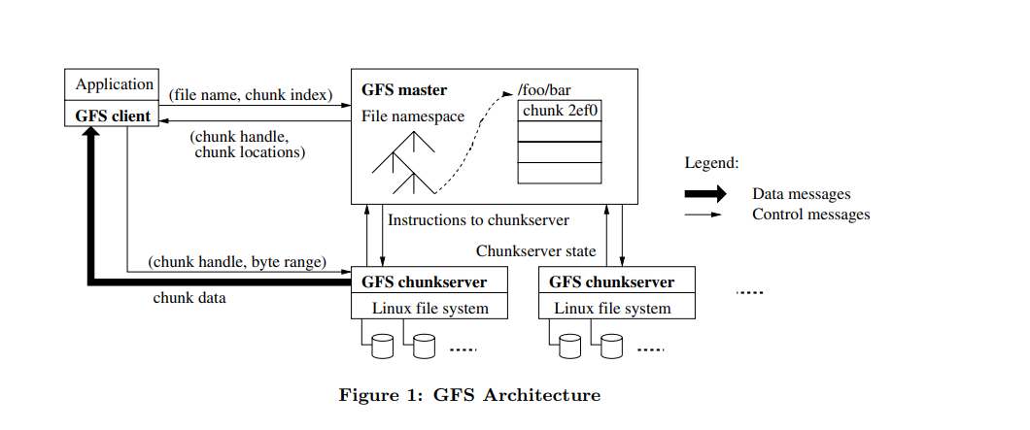

Slide 96
Features of GFS :
Namespace management and locking.
Fault tolerance.
Reduced client and master interaction because of large chunk server size.
High availability.
Critical data replication.
Automatic and efficient data recovery.
High aggregate throughput.

Slide 97
Advantages of GFS :
1. High accessibility Data is still accessible even if a few nodes fail. (replication) Component failures are more common than not, as the saying goes.
2. Excessive throughput, many nodes operating concurrently.
3. Dependable storing. Data that has been corrupted can be found and duplicated.
Disadvantages of GFS :
1. Not the best fit for small files.
2. Master may act as a bottleneck.
3. Unable to type at random.
4. Suitable for procedures or data that are written once and only read (appended) later.

Slide 98
Hadoop distributed file system (HDFS) :
HDFS is a DFS based on GFS that provides high throughput access to application data.
It uses the commodity hardware with the expectation that failures will occur and provides portability across hetrogeneous hardware and software platforms.
HDFS is acquired by Hadoop Apache open source project to handle to big data.
The Hadoop core consists of two modules :
1. Hadoop distributed file system: Used for storing huge amount of data.
2. MapReduce programming mode : Used for processing of large amount of data.

Slide 99
HDFS is a unique design that provides storage for extremely large files with streaming data access pattern and it runs on commodity hardware.
Let’s elaborate the terms:
Extremely large files: Here we are talking about the data in range of petabytes(1000 TB).
Streaming Data Access Pattern: HDFS is designed on principle of write-once and read-many-times. Once data is written, large portions of dataset can be processed any number times.
Commodity hardware: Hardware that is inexpensive and easily available in the market. This is one of feature which specially distinguishes HDFS from other file system.

Slide 100
Architecture of HDFS :
An HDFS cluster consists of multiple commodity machines that can be classified into the following three types :
1. Name node (runs on master machine)
2. Secondary name node or backup node (runs on separate machine)
3. Data node (runs on slave machine)
The working of an HDFS is the same as master slave architecture.
Master is the name node that contains the metadata of the cluster, but the processing occurs through data nodes.

Slide 101
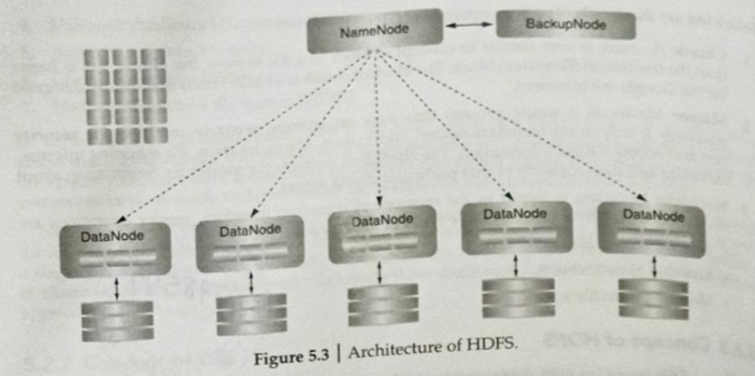

Slide 102
Nodes: Master-slave nodes typically forms the HDFS cluster.
1. NameNode(MasterNode):
Manages all the slave nodes and assign work to them.
It executes filesystem namespace operations like opening, closing, renaming
files and directories.
It should be deployed on reliable hardware which has the high config. not on commodity hardware.
2. DataNode(SlaveNode):
Actual worker nodes, who do the actual work like reading, writing, processing etc.
They also perform creation, deletion, and replication upon instruction from the master.
They can be deployed on commodity hardware.

Slide 103
HDFS daemons: Daemons are the processes running in background.
1. NameNodes:
Run on the master node.
Store metadata (data about data) like file path, the number of blocks, block Ids. etc.
Require high amount of RAM.
Store meta-data in RAM for fast retrieval i.e to reduce seek time. Though a persistent copy of it is kept on disk.
2. DataNodes:
Run on slave nodes.
Require high memory as data is actually stored here.

Slide 104
Terms related to HDFS:
HeartBeat : It is the signal that datanode continuously sends to namenode. If namenode doesn’t receive heartbeat from a datanode then it will consider it dead.
Balancing : If a datanode is crashed the blocks present on it will be gone too and the blocks will be under-replicated compared to the remaining blocks. Here master node(namenode) will give a signal to datanodes containing replicas of those lost blocks to replicate so that overall distribution of blocks is balanced.
Replication: It is done by datanode.
No two replicas of the same block are present on the same datanode.

Slide 105
Features of HDFS :
Distributed data storage.
Blocks reduce seek time.
The data is highly available as the same block is present at multiple datanodes.
Even if multiple datanodes are down we can still do our work, thus making it highly reliable.
High fault tolerance.

Slide 106
Limitations of HDFS :
Low latency data access: Applications that require low-latency access to data i.e in the range of milliseconds will not work well with HDFS, because HDFS is designed keeping in mind that we need high-throughput of data even at the cost of latency.
Small file problem: Having lots of small files will result in lots of seeks and lots of movement from one datanode to another datanode to retrieve each small file, this whole process is a very inefficient data access pattern.

Slide 107
Comparisons of Features between GFS and HDFS :
Architecture :
Both GFS and HDFS use a master-slave architecture. In GFS, the master is called the Master Server, and in HDFS, it's called the NameNode.
Platform
GFS works on Linux, while HDFS works on cross platforms.
Servers
GFS has two servers: master and chunk. HDFS has three servers: name, data, and secondary.
Data storage
GFS is designed for storing and managing large files. HDFS is for high throughput and low-latency data access.

Slide 108
Data size
GFS has a default chunk size of 64 MB, but this can be changed by the user. HDFS has a default DataNode size of 128 MB, but this can also be changed by the user.
Snapshots
HDFS allows up to 65,536 snapshots for each directory. In GFS, each directory and file can be snapshotted.
File appends
GFS allows multiple appends and multiple clients to append simultaneously.
Design
GFS was designed to meet Google's rapidly growing needs. HDFS has a hierarchical namenode and datanode architecture.

Slide 109
